Slide 1
Geography of China

Slide 2
Objective: Analyze how China’s geographic features effected its civilization and development
Do Now: The Pillars of Asoka and Hammurabi’s Code are similar to:
The 12 Tables of Rome

Slide 3
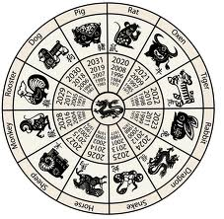
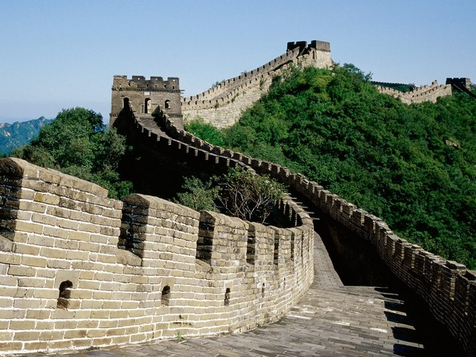
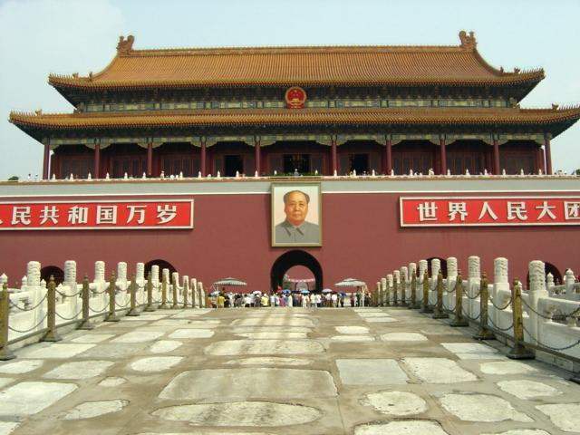
What comes to mind when you see these images?

Slide 4
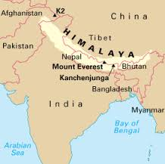
China

Slide 5
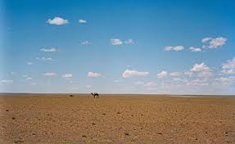
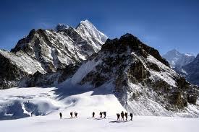
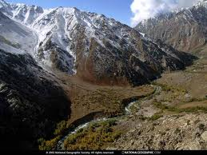
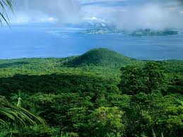
CHINA GEOGRAPHY

Slide 6
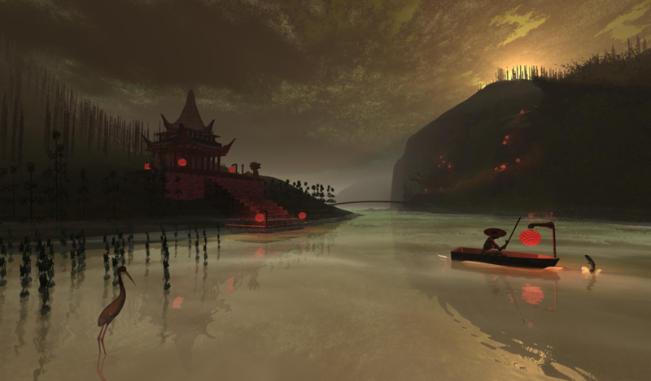
The Yellow (Huang) River
Ancient people first settled in China along the Huang River aka Yellow River (yellow soil) aka River of Sorrows (flood causing disaster and death)

Slide 7
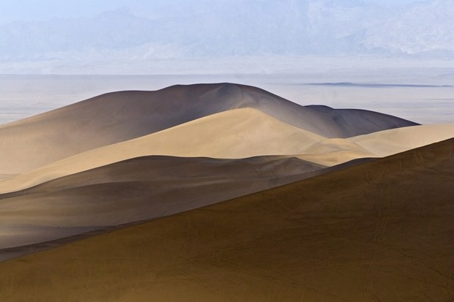
Deserts
West of the Yellow River is Gobi Desert

Slide 8
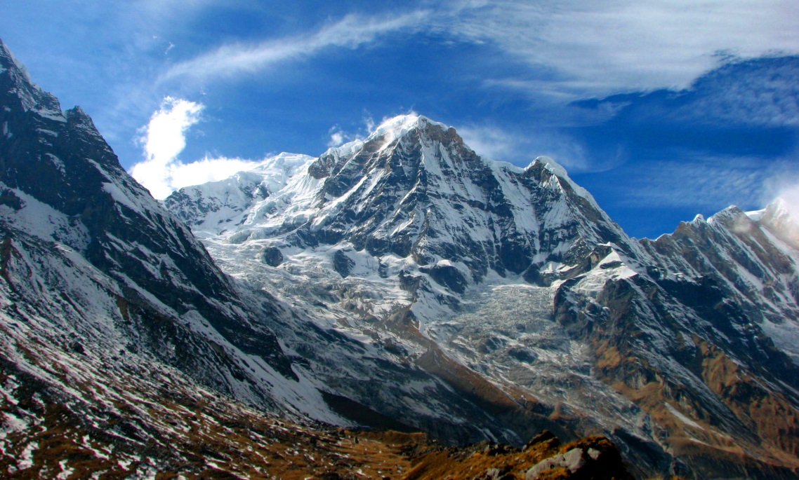
Mountains
South and west of the Yellow River are the Himalaya (tallest mountain range in the world) and Tian Shan

Slide 9
Ocean
To the east of China is the Pacific Ocean

Slide 10
Rain Forest
Divided China from Southeast Asia

Slide 11
Effects
Having all these imposing geographic features surrounding their civilization had the following effects on the ancient Chinese:
Isolated
Kept traditional ways
Lack of cultural diffusion, untainted
Thought their way of doing things were right
Had a small view of the world

Slide 12
Summary
Using the information from todays class and your notes please answer the questions on the worksheet

